Slide 1
Step by Step Excel

Slide 2
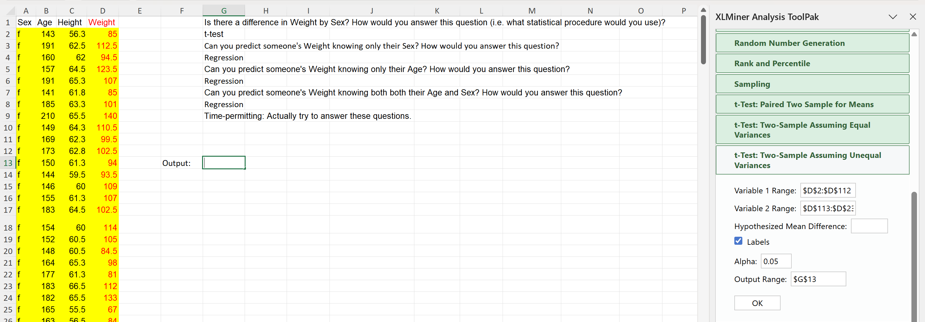
Question: Is there a difference in weight by sex?
*a. Select only the cells for the female data range
*b. Select only the cells for the female data range
Male data range starts at cell D113
Step-by-step t-test in Excel with Xlminer
Step 0 – Install Statistical Add-in
Step 1 – select test for your question
Step 2 – select data*
Step 3 – confirm mean diff. expected
Step 4 – define output range
Step 5 – click OK to run test

Slide 3
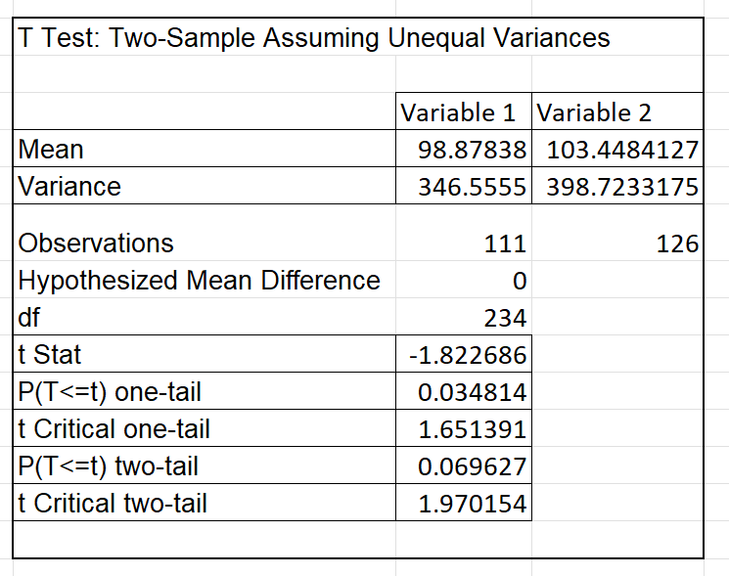


Results and how to interpret t-test output
Interpret the t-test output
Step 1 – what is the p-value?
Step 2 – if p-value is less than 0.05 we have statistical significance
Step 3 – evaluate against your hypothesis
Step 4 – reject or do not reject the null based on p-value compared to confidence
H0: There is no difference in weight by sex.
H1: There is a difference in weight by sex.

Slide 4
Now what?
Proving that there is a statistically significant difference offers us the opportunity to then explore what drives that difference. With our simple example, this may not seem very necessary.
What we are asking if we try to determine if we can predict weight by sex is can we predict a quantitive and continuous ratio variable based on a qualitative and categorical variable for a given dataset?
What situations can you think of where this could be helpful in your work or in society as a whole?
Where can this “go wrong” instead of being used to help?
How do we need to balance the ethics of building a model to do this type of prediction?
Notes:
In our example, we are happy to accept that there will be a difference of a person’s weight since we know there are some biological differences in body structure between those identified as male or female at birth.

Slide 5
Prediction – Regression and ANOVA
The two most commonly used prediction tools are the analysis of variance and regression.
There are some key similarities conceptually and mathematically to consider.
both partition variance;
both estimate model parameters using linear modeling frameworks;
both use F‑tests built on ratios of explained vs. unexplained variance.
What are some differences?
Why would we need, or prefer, to use one over another?
Notes:
both estimate model parameters - how much of the variance observed can be accounted for by

